Slide 1
Memory Management

Slide 2
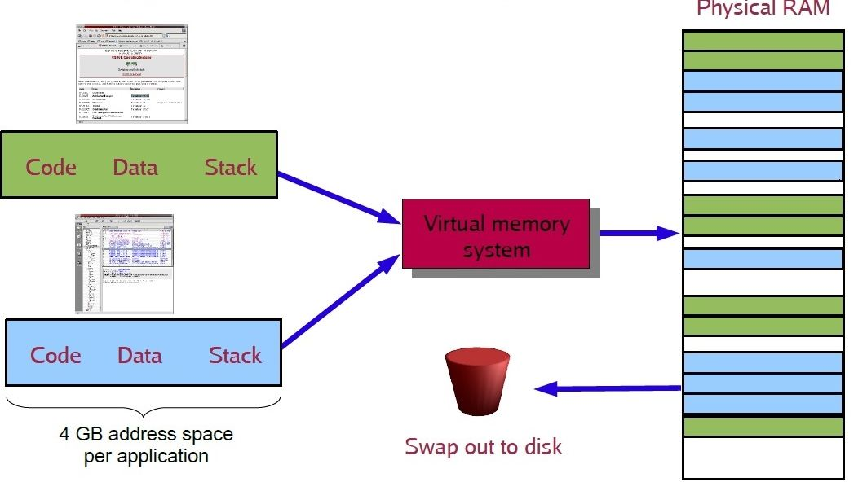
Virtual memory
It is a way of using disk space to extend the amount of available RAM on a computer.
This allows a computer to compensate for physical memory shortages, temporarily transferring data from random access memory (RAM) to disk storage.

Slide 3
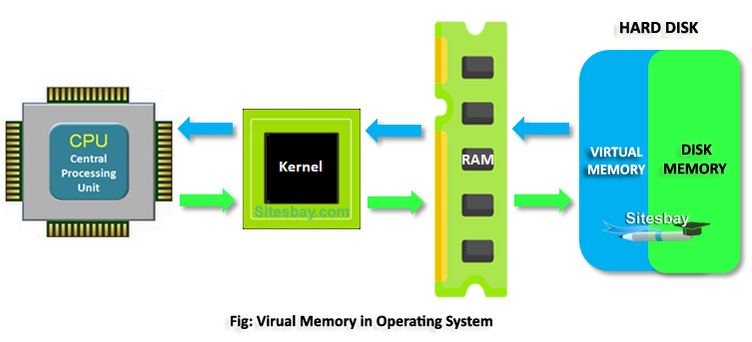
What is Paging?
In a virtual memory system, the operating system divides a computer's physical memory into small units called pages. These pages are then mapped to a portion of the computer's storage space, like a hard drive or SSD, which serves as an extension of the computer's RAM.
When a program needs to access data that is not currently in RAM, the operating system swaps out some of the data in RAM to the disk to make room for the new data.

Slide 4
The Paging Process
Memory is split up into partitions of blocks of fixed size
Physical memory blocks are known as frames
Fixed-sized logical memory blocks are known as pages
A program is allocated a number of pages that is usually just larger than what was actually needed
The logical address stores the page number in the first part of address and the page offset in the remaining part of the address.
Page number: number of bits required to represent the pages in Logical address space.
Page offset: Number of bits required to represent a particular word in page.

Slide 5
Paging
Page table: the page map table shows the mapping to pages to page frames
Page: virtual memory divided into blocks of fixed size
Page frame: the main memory is divided into page frames of same size as page

Slide 6
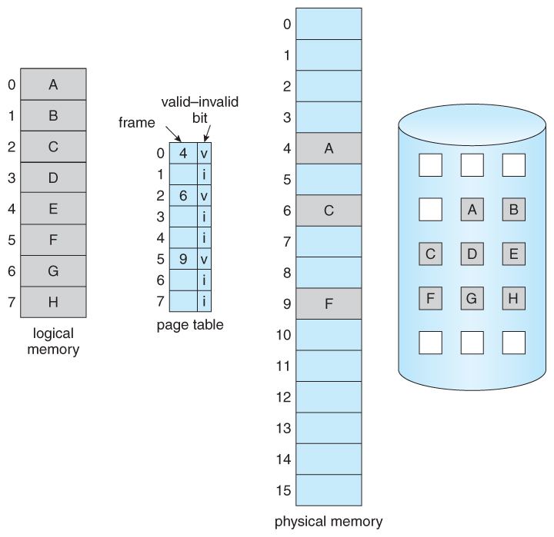
How paging is used to handle virtual memory
Divide main memory/RAM into frames
Divide virtual memory into blocks of same size called pages
Frame/pages are a fixed size
Set up a page (map) table that translates logical to physical address
Keeps track of all free frames
Swap pages in memory with new pages from disk when needed

Slide 7
What is memory Segmentation?
Logical address space is broken up into variable-size memory blocks called segments
Segment can be of varying size
Each segment has name and size
During execution
Segments from the logical memory are loaded into physical memory
Address = segment number + offset value; found in segment map table
Offset value decides the size of the segment

Slide 8
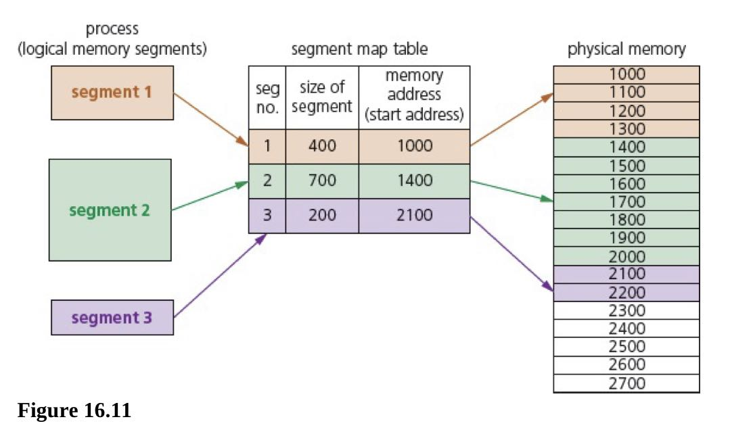
Segmentation

Slide 9
Difference Between Paging and Segmentation
Paging | Segmentation
A page is a fixed-size block of memory | A segment is a variable-size block of memory
Since the block size is fixed, it is possible that call blocks may not be fully used - this can lead to internal fragmentation | Because memory blocks are a variable size, this reduces risk of internal fragmentation but increase the risk of external fragmentation.
The user provide a single value - this means that the hardware decides the actual page size | The user will supply the address in two values
A page table maps logical address to physical addresses(this contains the base address of each page stored in frame in physical memory space) | Segmentation uses a segment map table containing segment number + offset(segment size); it maps logical addresses to physical addresses
The process of paging is essentially invisible to the user/programmer | Segmentation is essentially a visible process to user/programmer
Procedures and any associated data cannot be separated when using paging | Procedures and any associated data can be separated when using segmentation
Paging consists of static link and dynamic loading | Segmentation consists of dynamic linking and dynamic loading
Pages are usually smaller than segments | Segments are usually larger than pages

Slide 10
Disk thrashing
The main drawback of using HDD in virtual memory is that as main memory fills, more and more data/pages need to be swapped in and out of virtual memory. This leads to high rate of hard disk read/write head movement. if more time is spent on moving pages in and out of memory than actually doing any processing, then the processing speed of the computer will be reduced. A point can be reached when the execution of a process comes to a halt since the system is so busy paging and in and out of memory; this is known as the thrash point.
• It is a costly technique as compared to the other one. • External fragmentation is there in it. • Since there is a variably sized partition. So, it is difficult to allocate memory to them.

Slide 11
Disk thrashing
Pages are requested back into RAM as soon as they are moved to the disk
There is continuous swapping (of the same page)
No useful processing happens (deadlock)
Pages that are in RAM and disk are interdependent
All processing times are used for swapping pages

Slide 12
Page Replacement
Page replacement occurs when a requested page is not in memory. When paging in/out from memory, it is necessary to consider how the computer can decide which page to replace to allow the requested page to be loaded.
When a new page is requested but is not in memory, a page fault occurs and the OS replaces one of the existing pages with the new page. How to decide which page to replace is done in a number of different ways, but all methods have the same goal of minimizing the number of page faults.
A page fault is a type of interrupt raised by hardware. When a running program accesses a page that is mapped into virtual memory address space, but not yet loaded into physical memory, then the hardware needs to raise this page fault interrupt.

Slide 13
Page Replacement
How to decide which page to replace is done in a number of different ways, but all methods have the same goal of minimizing the number of page faults.
First in first out (FIFO) The OS keeps track of all the pages in memory using a queue structure. The oldest page is at the front of the queue and is the first to be removed when a new page needs to be added
Optimal page replacement looks forward in time to see which frame it can replace in the event of a page fault. With least recently used page replacement (LRU), the page which has not been used for the longest time is replaced.

Slide 14

Students’ Activity
Record the answers to the following questions in your copy books
One role of the operating system is the provision of a virtual machine What does this mean?
Explain in detail using the correct computer terms how a virtual machine is created
State the difference between paging and segmentation

